Slide 1
Fitness Chatbot
By Ashish Mernedi
016662360

Slide 2
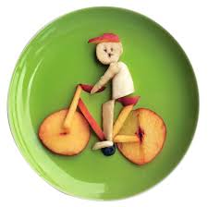
Motivation
For fitness interested individuals, this bot can be helpful for calculating number of calories in the food they took.
Also, it helps them to know the diet labels associated with and how to prepare them.
Not only that, we can know what type of cuisine dish belongs, meal type and many more.

Slide 3
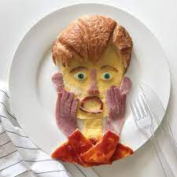
Challenges Faced
Identifying food items that are a variant of other food items.
Finding an API which contains all the data.
We are currently using APIs from edamam.
What models need to be used for better detection of food names?
Clubbing of multiple APIs

Slide 4
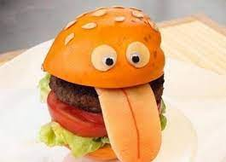
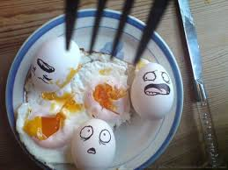
Demo

Slide 5
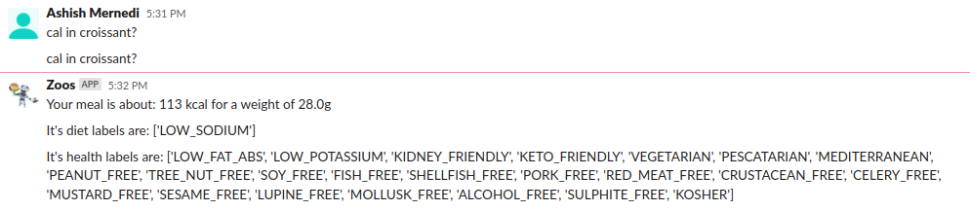
Demo

Slide 6
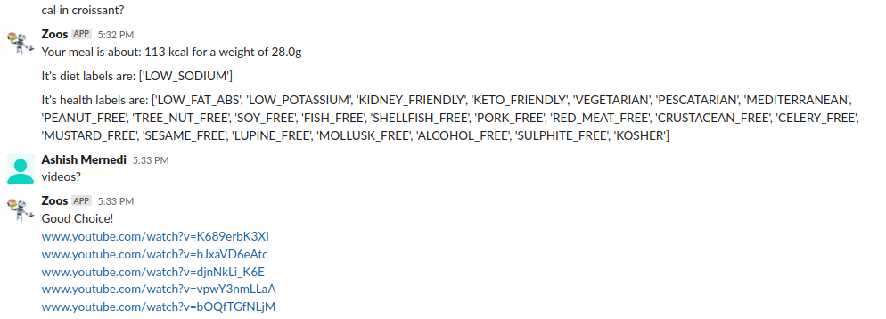
Multi-turn Conversation - 1

Slide 7
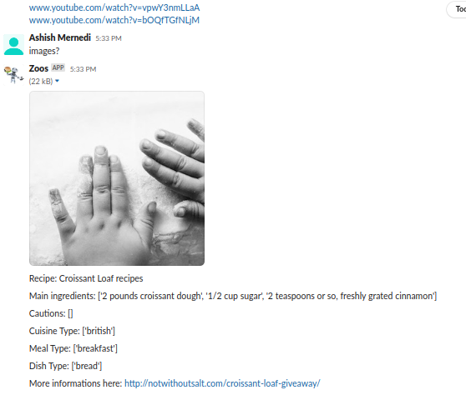
Multi-turn Conversation - 2

Slide 8
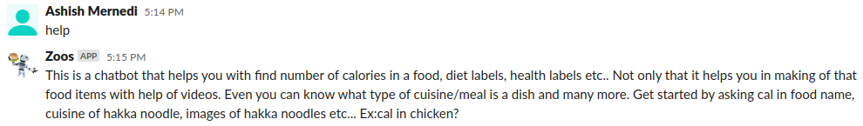
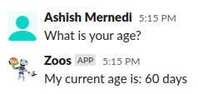

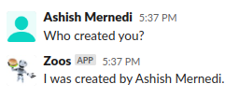
Some other conversations

Slide 9
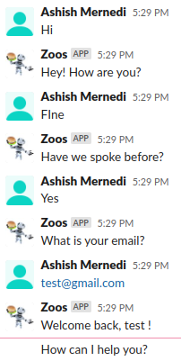
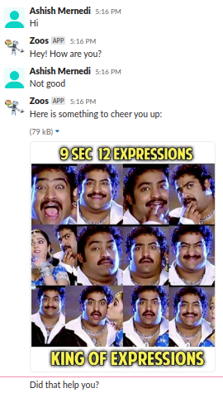
Other conversations

Slide 10
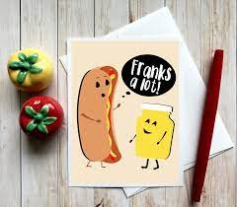
Thank You

